Slide 1

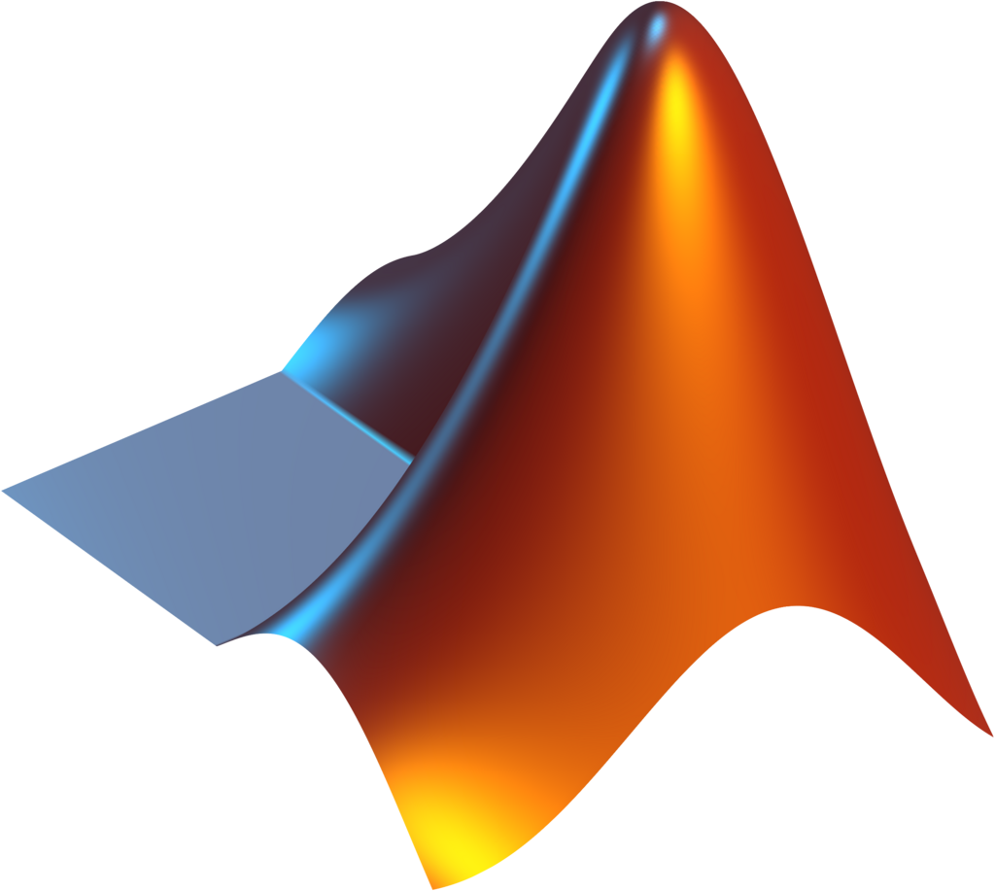
Recursive Programming in Numerical Methods
A presentation on solving the reaction rate equation x - sin(x) = 0 using recursive numerical methods and comparing recursive vs. dynamic programming performance.

Slide 2
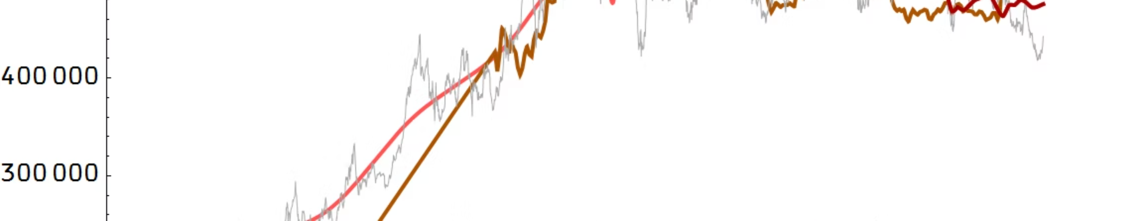
Chapter 1: Recursive Numerical Solvers
Goal
Methods Used
Parameters
Solve the reaction rate equation x - \sin(x) = 0 using equivalent code based on recursive programming.
Newton-Raphson Method
Tolerance: 1e-6
Secant Method
Maximum Iterations: 100

Slide 3


Newton-Raphson Recursive Function
The Newton-Raphson method uses the function derivative to iteratively estimate the root.
The recursive function newton_recursive() calls itself with the updated estimate until convergence is achieved (|f(x)| < \text{tol}).
Update Formula: x_{\text{new}} = x_{\text{old}} - f(x_{\text{old}}) / f'(x_{\text{old}})
Where f(x) = x - \sin(x) and f'(x) = 1 - \cos(x).

Slide 4

Secant Method Recursive Function
The Secant method approximates the derivative using two prior estimates, avoiding direct derivative computation.
The function secant_recursive() takes two starting guesses and updates them recursively until convergence.
Update Formula: x_{\text{new}} = x_1 - f(x_1) \cdot (x_1 - x_0) / (f(x_1) - f(x_0))
This method is generally slower than Newton-Raphson but requires less initial information.

Slide 5
Verification of Solutions
Both methods successfully found the root, which was verified by plugging the result back into the original equation f(x) = x - \sin(x).
Method
Iterations
Verification (f(x))
Newton-Raphson
4
2.8e-06
Secant
7
1.93e-9
The resulting f(x) values are very close to zero, confirming the accuracy of the roots found.

Slide 6


Chapter 2: Recursive vs. Dynamic Programming
Comparison of Computational Efficiency
Recursive (Rec)
Dynamic Programming (DP)
Solves problems by breaking them down into smaller instances of the same problem. Often leads to repeated calculations (e.g., O(2^n) for Fibonacci).
Stores results of subproblems (memoization or tabulation) to avoid re-computation. Significantly improves efficiency (e.g., O(n) for Fibonacci).

Slide 7

Case Study 1: Fibonacci Series
The Fibonacci sequence is a classic example demonstrating the performance difference between recursive and DP approaches.
Recursive Fibonacci
Dynamic Programming Fibonacci
Exponential time complexity O(2^n) due to repeatedly calculating the same values.
Linear time complexity O(n) by storing computed values and building the solution bottom-up.
result = fib_rec(n-1) + fib_rec(n-2);
fib(i) = fib(i-1) + fib(i-2);

Slide 8


Case Study 2: 0/1 Knapsack Problem
The Knapsack problem seeks to maximize value within a fixed capacity.
Recursive Knapsack
Dynamic Programming Knapsack
Explores all combinations (include or exclude item), leading to exponential complexity O(2^n).
Uses a 2D table to store solutions to subproblems, achieving polynomial complexity O(n \times \text{capacity}).

Slide 9
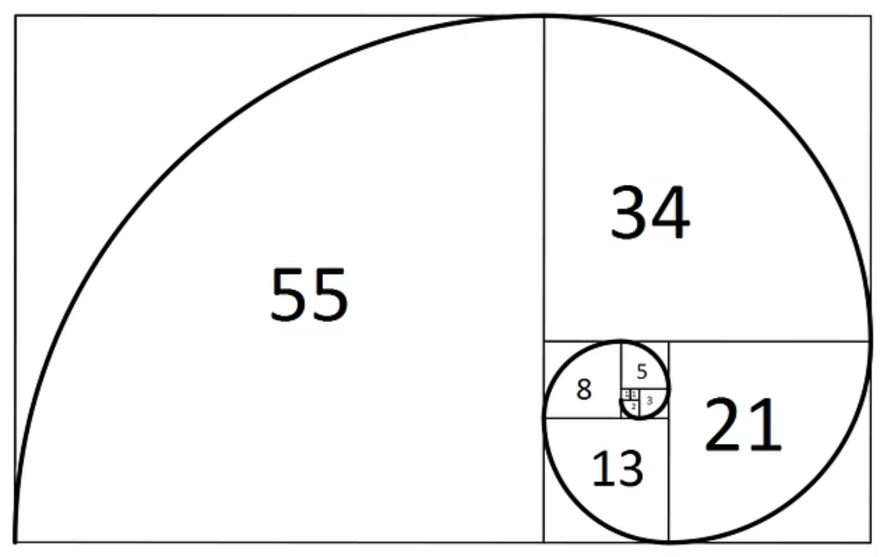
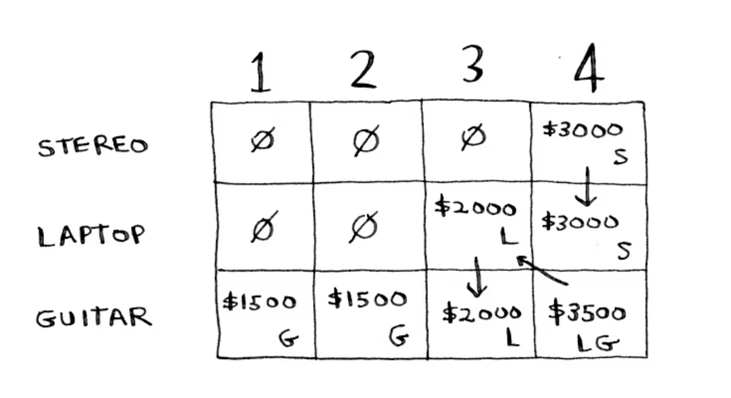

Performance Comparison: DP vs. Recursion
Plots clearly show that Dynamic Programming is significantly faster than pure recursion for problems with overlapping subproblems.
For Fibonacci, the speedup ratio increases dramatically as n grows, highlighting the inefficiency of repeated calculations in pure recursion.

Slide 10



Conclusion and Key Takeaways
Programming Concepts
Efficiency Matters
Foundational Skills
Gained experience with MATLAB programming, recursive functions, and the foundations of numerical methods.
Dynamic Programming provides massive performance improvements over pure recursion by eliminating redundant computations.
Applied concepts to solve classical problems (Fibonacci, Knapsack) and numerical equations (Reaction Rate Solver).
References include MATLAB Documentation, lecture notes, and online resources for algorithmic concepts.

